Slide 1
OPTICAL FIBRE PRINCIPLES
Linear Transmission
Light Guidance in Fibres
Optical Fibre Types
Scattering and Absorption Loss
Material Dispersion
Impact of Dispersion
Polarisation Mode Dispersion
Notes:
First shown to be feasible in 1966 by Kao and Hockham.
By 1976 it had become an experimental reality
And by 1986 a major installed transmission technology.
In 1997 research labs first crossed the 1Tb/s in a single fibre, today >100Tb/s systems are in the pipeline.
What has been said about optical fibre.
Effectively Unlimited bandwidth
Near Zero signal attenuation
Near Zero signal distortion
Near zero power requirements
Near zero physical size
Comparatively cheap.
Frequency range > 25Thz possible

Slide 2
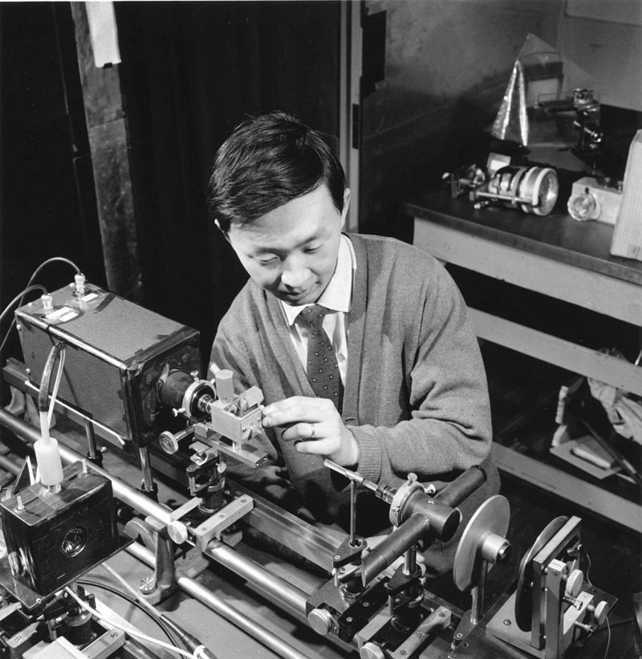
Kao and Hockham
In 1966 at STC Labs in Harlow, England, it was shown that glass could be used to guide light.
NOBEL Prize for Physics 2009
Studied under Prof Harold Barlow at UCL

Slide 3
What does an optical system look like?
Laser Diode
Photodiode

Slide 4
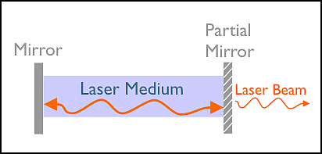
Laser Cavity

Slide 5
Photodiode
photodetection event
free carriers (electron-hole pair) produced, drift under influence of applied field, yielding photocurrent
Photon, E = hf
P
Depletion
regions
I
N

Slide 6
How small do we have to make it?
Needle ~500μm =0.5mm
Human Hair ~100μm
Multi Mode Fibre Core ~50μm
Single Mode Fibre
Core ~5μm

Slide 7
OPTICAL FIBRE PRINCIPLES
Light Guidance in Fibres
Notes:
First shown to be feasible in 1966 by Kao and Hockham.
By 1976 it had become an experimental reality
And by 1986 a major installed transmission technology.
In 1997 research labs first crossed the 1Tb/s in a single fibre, today >100Tb/s systems are in the pipeline.
What has been said about optical fibre.
Effectively Unlimited bandwidth
Near Zero signal attenuation
Near Zero signal distortion
Near zero power requirements
Near zero physical size
Comparatively cheap.
Frequency range > 25Thz possible

Slide 8
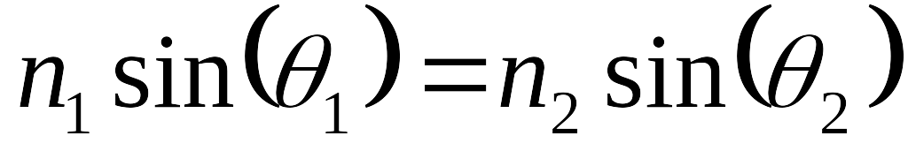
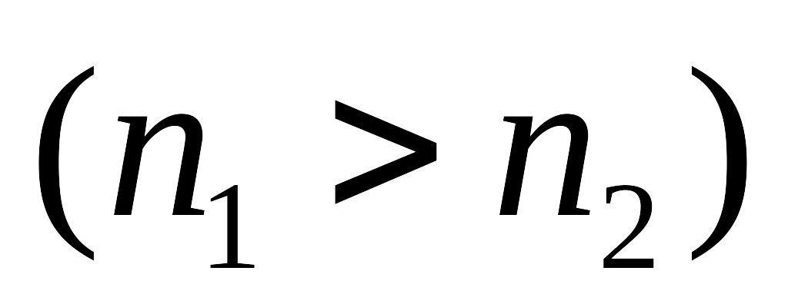


Guidance in an Optical Fibre
Snell’s Law
Ray refracted
Ray refracted
Material Refractive Index = n₂
Total Internal Reflection
Material Refractive Index = n₁
Normal to Surface
Notes:
Snells law n1 sin = n2 sin
Will Lead to total internal reflection
at the critical angle.
Lower refraction index > higher speed

Slide 9
Fibre Structure
cladding:
index n2<n1
core: radius a,
index n1
Notes:
Core surrounded by cladding both made primarily of Silica (SiO₂)
Refractive Index of a material is the ratio of the speed of light in a vacuum to the speed of light in that material.
Dopants (Impurities) can be added during manufacture to alter the refractive index.

Slide 10
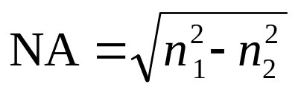
Total Internal Reflection
Cladding
Core
Cladding
The light gathering capacity of the fibre is quantified by the Numerical Aperture (NA)
Notes:
To obtain a simplified understanding of the operation of optical fibres we will use ray theory or geometric optics
Numerical aperture gives the angles of light that will be guided. Usually the difference in refractive index is small, 0.01

Slide 11
OPTICAL FIBRE PRINCIPLES
Optical Fibre Types
Notes:
First shown to be feasible in 1966 by Kao and Hockham.
By 1976 it had become an experimental reality
And by 1986 a major installed transmission technology.
In 1997 research labs first crossed the 1Tb/s in a single fibre, today >100Tb/s systems are in the pipeline.
What has been said about optical fibre.
Effectively Unlimited bandwidth
Near Zero signal attenuation
Near Zero signal distortion
Near zero power requirements
Near zero physical size
Comparatively cheap.
Frequency range > 25Thz possible

Slide 12
Modal Dispersion
Cladding
Core
Cladding
Notes:
To obtain a simplified understanding of the operation of optical fibres we will use ray theory or geometric optics
Numerical aperture gives the angles of light that will be guided. Usually the difference in refractive index is small, 0.01

Slide 13
Modal Dispersion
Cladding
Core
Cladding
Notes:
To obtain a simplified understanding of the operation of optical fibres we will use ray theory or geometric optics
Numerical aperture gives the angles of light that will be guided. Usually the difference in refractive index is small, 0.01

Slide 14
Modal Dispersion
Dispersion – A fibre property that causes difference parts of the light to travel at different velocities
Different path lengths result in fibre modes
A narrow pulse of energy will be spread out of a larger time period due to the different propagation velocities of the modes
Causes a severe penalty to digital transmission
We will meet other forms of dispersion later on….

Slide 15
Fibre Bends
Cladding
Core
Cladding
<25mm
Notes:
To obtain a simplified understanding of the operation of optical fibres we will use ray theory or geometric optics
Numerical aperture gives the angles of light that will be guided. Usually the difference in refractive index is small, 0.01

Slide 16
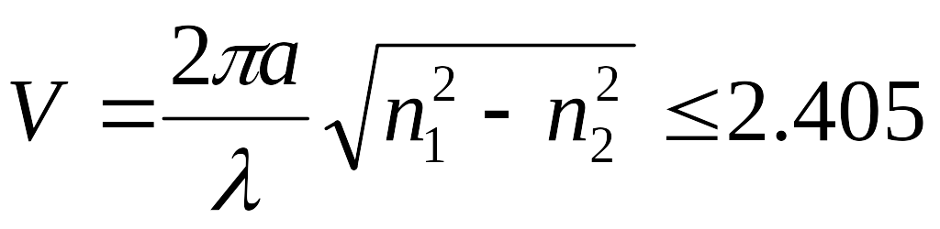
The Propagation Coefficient
If the core of the fibre is made very small ~5µm, only one mode can propagate ⇒ single mode fibre with mode dispersion ≅ 0.
The condition for single mode is:
From the solution of Maxwells equations.
Typical fibre V ≈ 2.2
Spot size increases as index difference is reduced, which leads to microbending loss
Notes:
Core size of the order of the wavelength of propagation. Geometric optics picture does not really explain what is happening. Wave Theory approach is require. NOT GIVEN HERE.
In effect what is happen is that the narrow core is refocusing the beam and counteracting the diffraction usually seen.
The parameter V comes from solving Maxwells equations. a is the core radius, n1 is the core refractive index, n2 the cladding refractive index. This for a fibre to be single mode at wavelength λ
Typically cladding is 125 μ m and core for multimode 50 μm, single mode 5 μ

Slide 17
Single Mode Fibre
If we look at the field distribution in a single mode fibre we see that the field penetrates into the cladding, typically to a distance of the order of one wavelength
Typical field distribution
Core
Notes:
Typically the difference between the refractive indices of the core and cladding are of the order of 0.003. Due to this small value energy is not strictly confined to the core. Giving what is known as a weakly guided state.
This result is the basis for a number of fibre devices, an example being fibre couplers, which allow the energy from one fibre to be coupled into two output fibre, or vice versa. With careful design it is possible of almost even power distribution between the two outputs.
However, the fact that the field also travels in the core can cause problems if the fibre is bent

Slide 18
Graded index fibres
α=
α=2
α=1
n
r
Radius
Refractive Index
50
0.1
Pulse Spreading
nS/km
2 α
core refractive index follows a parabolic profile.
Notes:
The refractive index of the core is given by:
Pulse spreading due to intermodal dispersion is greatly reduced, allowing high bit rates and longer distances. However these still cannot match the required bit rate- distance products required in modern systems.

Slide 19
Comparison of optical fibres.

Slide 20
OPTICAL FIBRE PRINCIPLES
Scattering and Absorption Loss
Notes:
First shown to be feasible in 1966 by Kao and Hockham.
By 1976 it had become an experimental reality
And by 1986 a major installed transmission technology.
In 1997 research labs first crossed the 1Tb/s in a single fibre, today >100Tb/s systems are in the pipeline.
What has been said about optical fibre.
Effectively Unlimited bandwidth
Near Zero signal attenuation
Near Zero signal distortion
Near zero power requirements
Near zero physical size
Comparatively cheap.
Frequency range > 25Thz possible

Slide 21
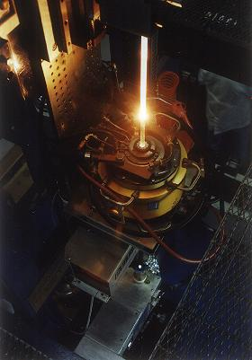
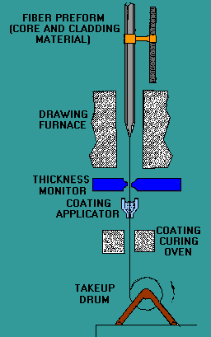
Optical Preform

Slide 22
Fibre Attenuation
Intrinsic loss due to ‘tails’ of UV (~200nm) and Infra-red (~10,000nm, Si-O bond resonance) absorption bands
Rayleigh scattering - local structural fluctuations ‘frozen in’ as the glass forms result in λ⁻⁴ dependent scattering in forward and reverse directions
Impurities - such as OH, with fundamental molecular vibration at 2800nm such that overtones at 1400nm and 900nm are significant
Bends and microbends - loss varies as exp(-R), significant for R< few cm and increasing rapidly with λ
Notes:
OH = Hydroxyl
Don’t bend > 100mm
Microbends radius fibre due to manufacturing.
Differential expansion of jacket and fibre.

Slide 23
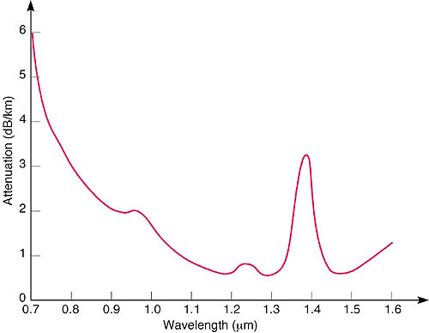
Fibre Loss Spectrum
Rayleigh
scattering
OH overtone
absorption peak
Loss ~ 0.35 dB/km at 1300nm, 0.2 dB/km at 1550nm
Loss < 0.18 possible using pure silica core with ‘index depressed’ cladding
Notes:
New types of fibre are coming on to the market that reduce the effects of the Hydroxyl peak.
So called dry fibre has a much lowered peak.
Normal fibre has a Water content as low as 1 part per 10^{9.} They can tolerate a total loss of around 30db before regeneration or amplification is required. Therefore that would limit transmission to 150Km

Slide 24
OPTICAL FIBRE PRINCIPLES
Material Dispersion
Notes:
First shown to be feasible in 1966 by Kao and Hockham.
By 1976 it had become an experimental reality
And by 1986 a major installed transmission technology.
In 1997 research labs first crossed the 1Tb/s in a single fibre, today >100Tb/s systems are in the pipeline.
What has been said about optical fibre.
Effectively Unlimited bandwidth
Near Zero signal attenuation
Near Zero signal distortion
Near zero power requirements
Near zero physical size
Comparatively cheap.
Frequency range > 25Thz possible

Slide 25
Dispersion - 1
Total chromatic dispersion is a combination of material and waveguide effects
Material dispersion
  Refractive index of silica varies with λ, reducing with increasing λ in the relevant region
  Group delay spread depends on the second derivative of refractive index with λ
Waveguide dispersion
  The mode propagation constant varies with λ, giving waveguide dispersion
Notes:
As mentioned before for Modal dispersion, dispersion is the name give to any effect where different components of the signal propagate at differing velocities. Modal dispersion was caused by the path length differences of the modes. Chromatic dispersion as the name suggests is down to the colour, or more precisely the wavelength of the light.
Physical Explaination
Waveguide Dispersion is in fact due to the signal travels in both the cladding and the core. Therefore the effective index is somewhere between the core and the cladding, depending on the power distribution between the signal in the core and the cladding. However, this power distribution is dependent on the wavelength of the signal. Therefore, changes in the wavelength cause the effective index to change.
Material and waveguide effects may have different signs, so may be used in the design of low dispersion fibre

Slide 26
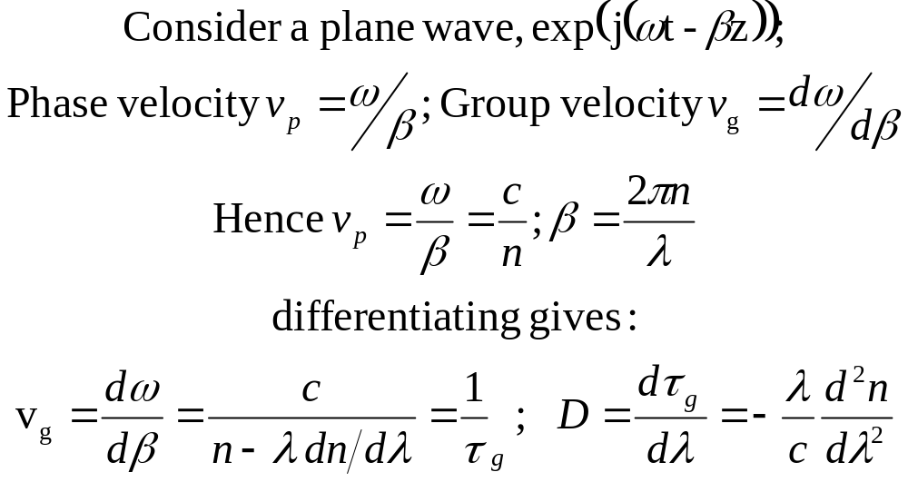
Dispersion - 2
Notes:
β is the propagation constant (as opposed to co-efficient). Z is the direction
We show here that β is not a linear function of angular frequency and therefore the group velocity is not constant. Chromatic dispersion is also known as group velocity dispersion (GVD)
D is sometimes term the group velocity dispersion parameter (GVD parameter)

Slide 27
Dispersion - 3
Group delay
μs/km
4.890
4.885
4.880
4.875
Wavelength,
nm
1000
1200
1400
1600
The group delay versus wavelength for silica has a minimum at λ ~ 1300nm

Slide 28
Dispersion - 4
20
material
total
Dispersion,
ps/(nm.km)
0
-20
waveguide
-40
-60
-80
Wavelength,
nm
1000
1200
1400
1600
Dispersion components for single-mode fibre
Zero material dispersion for silica ~ 1270 nm
Typically zero dispersion λ ~1310 nm for standard fibre
Notes:
Average @ 1300nm = 0 @1550 = 18ps/km nm

Slide 29
Dispersion - 5
D=0 at λ=1310nm for SMF and operation at this wavelength minimises pulse spreading
D<0 is referred to as the normal dispersion regime; operation at D>0 corresponds to anomalous dispersion
With normal dispersion higher frequency components travel slower than lower frequency components in a pulse and vice-versa for anomalous dispersion
Operation at the dispersion zero, with β₂=0, does not result in zero pulse dispersion since higher-order effects play a part
Little control over material dispersion, much greater control over waveguide dispersion

Slide 30
OPTICAL FIBRE PRINCIPLES
Impact of Dispersion
Notes:
First shown to be feasible in 1966 by Kao and Hockham.
By 1976 it had become an experimental reality
And by 1986 a major installed transmission technology.
In 1997 research labs first crossed the 1Tb/s in a single fibre, today >100Tb/s systems are in the pipeline.
What has been said about optical fibre.
Effectively Unlimited bandwidth
Near Zero signal attenuation
Near Zero signal distortion
Near zero power requirements
Near zero physical size
Comparatively cheap.
Frequency range > 25Thz possible

Slide 31
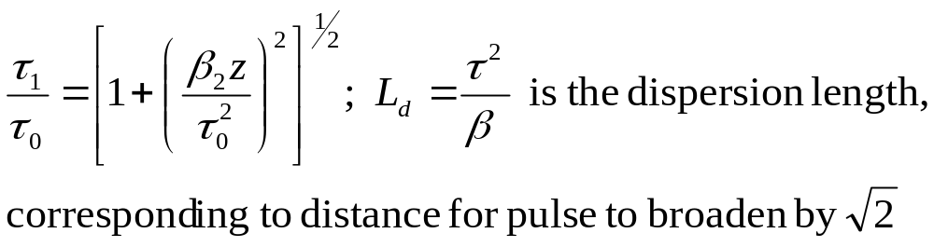
Pulse Spreading
Finite source linewidth and non-zero fibre dispersion cause pulses to spread out as they propagate along a fibre
Even with an ideal source of zero linewidth, once modulated to produce a pulse or data signal, there are information sidebands - essentially a form of line broadening inversely proportional to pulse duration
As an illustration, for an ideal Gaussian pulse and operation away from D=0, the pulse broadens with distance, z, as below

Slide 32

Dispersion – Single Pulse

Slide 33
Dispersion – Two Pulses

Slide 34
Dispersion Shifted Fibre
20
standard monomode
fibre (SMF)
Dispersion,
ps/(nm.km)
0
dispersion-shifted
fibre
-20
Wavelength,
nm
-40
1000
1200
1400
1600
Dispersion in SMF ~ 0 for 1300nm but ~17 ps/(nm.km) for 1550 nm
By reducing core size and manipulating the index profile the waveguide dispersion can be enhanced such that for wavelengths ~1550nm, where it is of opposite sign to material dispersion - the total chromatic dispersion is brought to zero

Slide 35
Dispersion Compensating Fibre
Much as with dispersion shifted fibre (DSF) but taken further, such that the overall chromatic dispersion for DCF is strongly negative at 1550nm
Cascading appropriate lengths of DCF with SMF can produce overall net zero dispersion
It is difficult in practice to achieve dispersion values more than 10 times that of SMF, so substantial lengths of DCF are required to achieve effective compensation

Slide 36
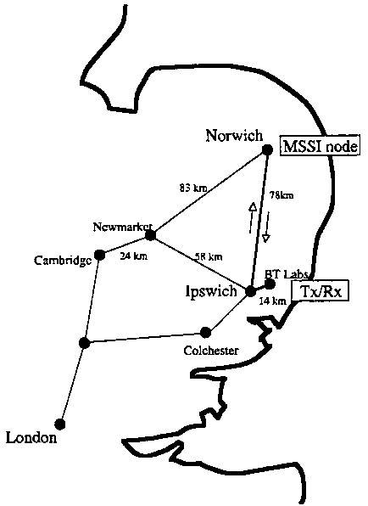
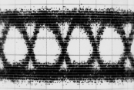
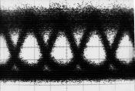
Dispersion Compensated Link -Example
Investigation of XPM distortion
using link between BT-Labs
and Norwich, UK
Installed fibre: 184km of SSMF
Laboratory experiments for
comparison (UCL)
Norwich
EDFA
92km
Cambridge
BT/Ipswich
Tx/Rx
London
LEANET
DCF 1
SSMF 1: 92km
SSMF 2: 92km
DCF 2
DCF 3
T_{x}
R_{x}
3x
16dBm
12dBm
Norwich
From H J Thiele, R Killey, P Bayvel, UCL Optical Networks Group

Slide 37
OPTICAL FIBRE PRINCIPLES
Polarisation mode Dispersion
Notes:
First shown to be feasible in 1966 by Kao and Hockham.
By 1976 it had become an experimental reality
And by 1986 a major installed transmission technology.
In 1997 research labs first crossed the 1Tb/s in a single fibre, today >100Tb/s systems are in the pipeline.
What has been said about optical fibre.
Effectively Unlimited bandwidth
Near Zero signal attenuation
Near Zero signal distortion
Near zero power requirements
Near zero physical size
Comparatively cheap.
Frequency range > 25Thz possible

Slide 38
Orthogonal Polarisations
A so-called single mode fibre supports TWO orthogonal, linearly polarised modes
Degenerate in a fibre with perfect circular symmetry they are in practice distinct

Slide 39
Polarisation Mode Dispersion
A so-called monomode fibre supports two orthogonally polarised modes, degenerate with perfect cylindrical symmetry
In practice a fibre is slightly birefringent due to non-perfect symmetry
Polarisation state of signal evolves as it propagates
There is a group delay difference between the two polarisation states, giving rise to polarisation mode dispersion (PMD)
Notes:
Light launched into the fibre with linear polarisation quickly reaches a state of arbitrary polarisation.
If you launch two signals with orthogonal SoP they exit with orthogonal SoP
Typically PMD around

Slide 40
Polarisation Mode Dispersion
Time-domain effect of polarisation mode dispersion (PMD) in a short fibre
SOP
Fibre Axis

Slide 41
Summary
Attenuation
  Scattering
  Absorbtion
Dispersion
  Modal Dispersion
  Material
  Waveguide
  Total chromatic dispersion
  Normal & anomalous regimes
  Pulse spreading/compression
Polarisation Mode Dispersion

